Slide 1

ACADEMIC GROUP PROJECT
C-DAC Student
Management System
A unified academic portal for students to access
academic, attendance, assignment and placement services.
React.js
Spring Boot
Microservices
MySQL
Batch : February 2026
Group Members :
Saurabh Agrawal
Devendra Ramesh Injapuri
Shailesh Taterao Bhure
Mavuri Keerthana
Mentor : Mrs. Soumya

Slide 2
PROJECT OVERVIEW
02
One portal. Multiple student services.
Designed to bring day-to-day academic activities into a single, easy-to-use interface.
WHY THIS SYSTEM?
ACADEMICS
ATTENDANCE
A centralized academic portal
Marks & profile
Eligibility tracking
• Access student profile and registration details.
• Monitor examination marks and attendance.
• Track assignments and submission status.
• Explore placement drives and eligibility.
• Receive notices and scheduled-event updates.
• Submit course and faculty feedback.
Student-facing module
Student-facing module
PLACEMENT
COMMUNICATION
Campus opportunities
Notices & feedback
Student-facing module
Student-facing module
C-DAC Student Management System

Slide 3
TECHNOLOGY & ARCHITECTURE
03
Modern full-stack architecture
Frontend, service layer and database are separated for maintainability and scalability.
Frontend
Backend
Architecture
React.js
Spring Boot
Microservices
Database
API
Persistence
MySQL
REST APIs
Spring Data JPA
Request & data flow
Student
→
React.js
→
Spring Boot
→
MySQL
Browser
UI Layer
Services
Data
C-DAC Student Management System

Slide 4
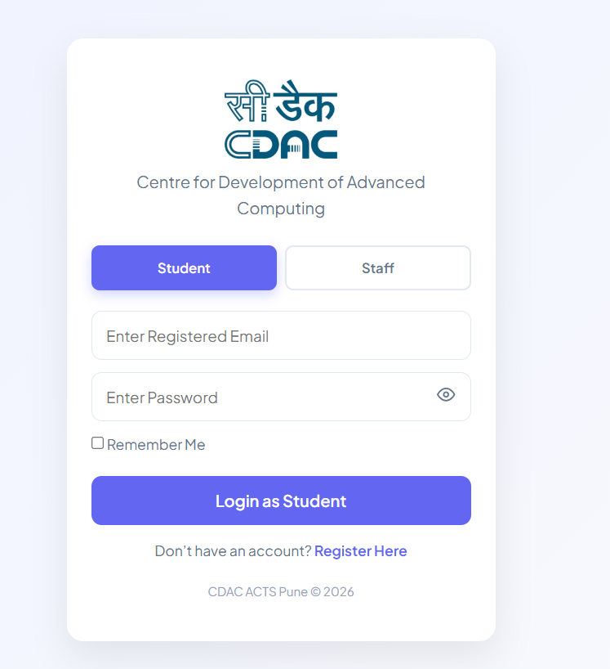
AUTHENTICATION
04
Secure student login
A clean entry point with role selection and registered-account authentication.
AUTHENTICATION
• Student / Staff login selection.
• Registered email and password fields.
• Remember-me and password visibility controls.
• Direct navigation to student registration.
Key user value
Student / Staff login selection.
C-DAC Student Management System

Slide 5
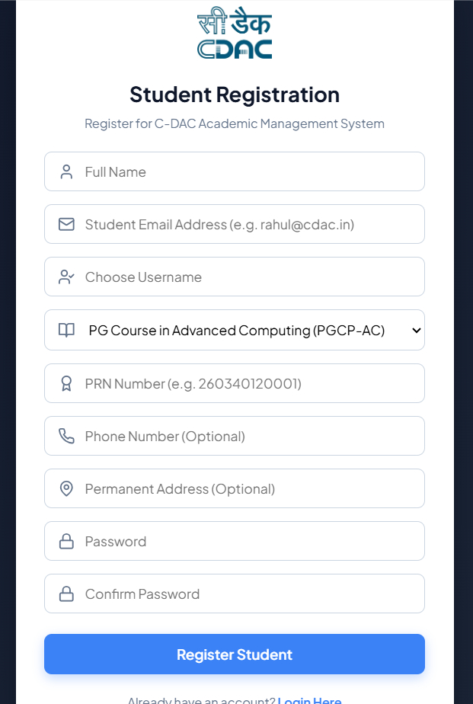
AUTHENTICATION
05
Student registration
New students can create their portal account with academic and contact information.
REGISTRATION
• Captures name, email and username.
• Selects the enrolled C-DAC course.
• Stores PRN, phone and address details.
• Password confirmation before registration.
Key user value
Captures name, email and username.
C-DAC Student Management System

Slide 6
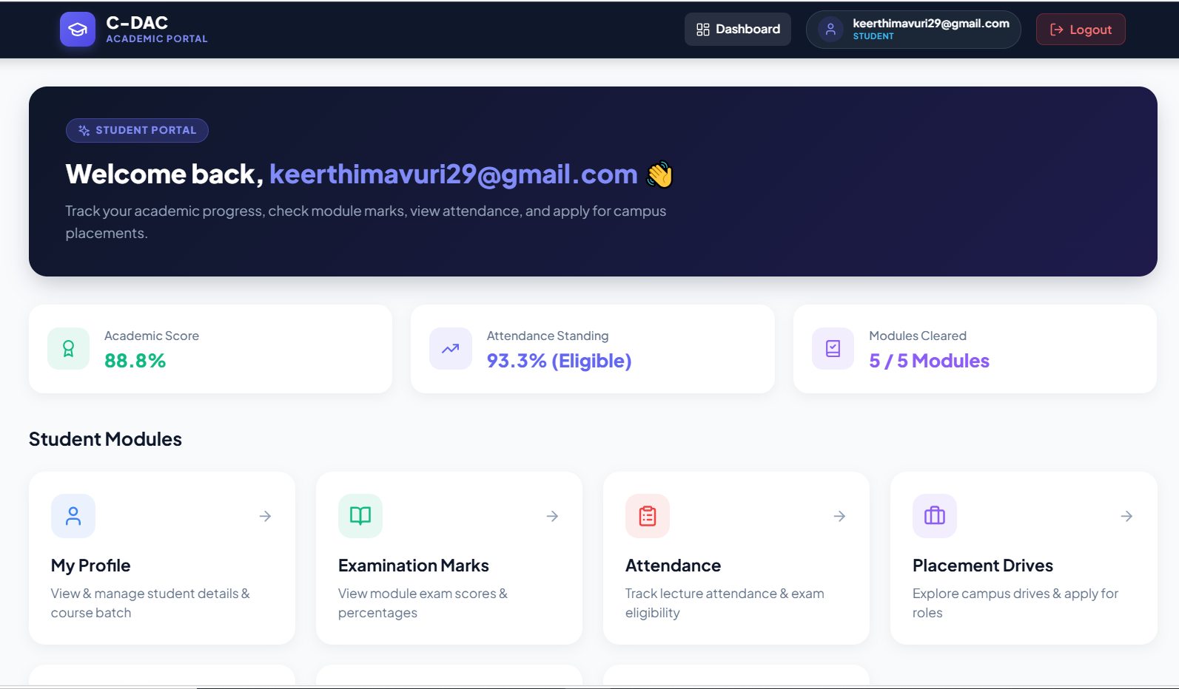
STUDENT EXPERIENCE
06
Student dashboard
The dashboard gives students a quick snapshot of academic progress and direct access to services.
DASHBOARD
• Academic score at a glance.
• Attendance standing and eligibility.
• Modules-cleared progress indicator.
• Quick access to all major portal modules.
Key user value
Academic score at a glance.
C-DAC Student Management System

Slide 7
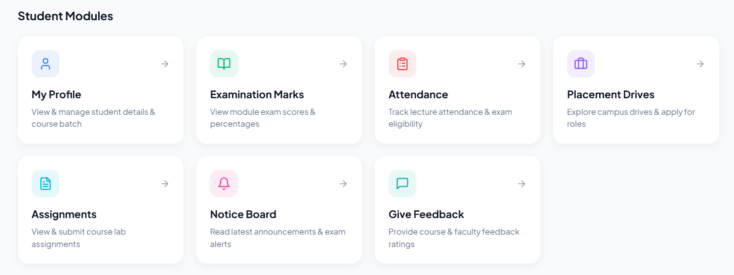
STUDENT EXPERIENCE
07
Student modules
A simple module hub keeps the portal organized and easy to navigate.
NAVIGATION
• Profile management.
• Examination marks.
• Attendance monitoring.
• Placement drives, assignments, notices and feedback.
Key user value
Profile management.
C-DAC Student Management System

Slide 8
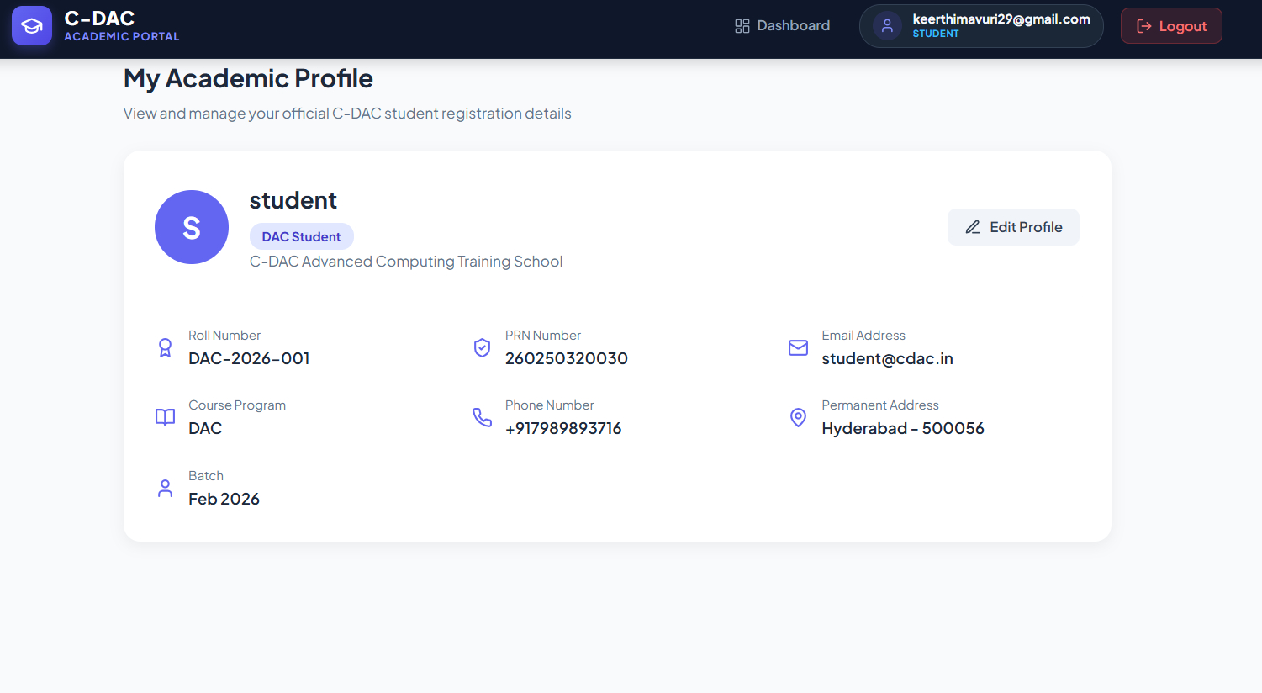
ACADEMIC MANAGEMENT
08
Academic profile
Students can view their official registration and course information from one place.
PROFILE
• Roll number and PRN details.
• Course program and batch information.
• Email, phone and permanent address.
• Edit Profile option for profile management.
Key user value
Roll number and PRN details.
C-DAC Student Management System

Slide 9
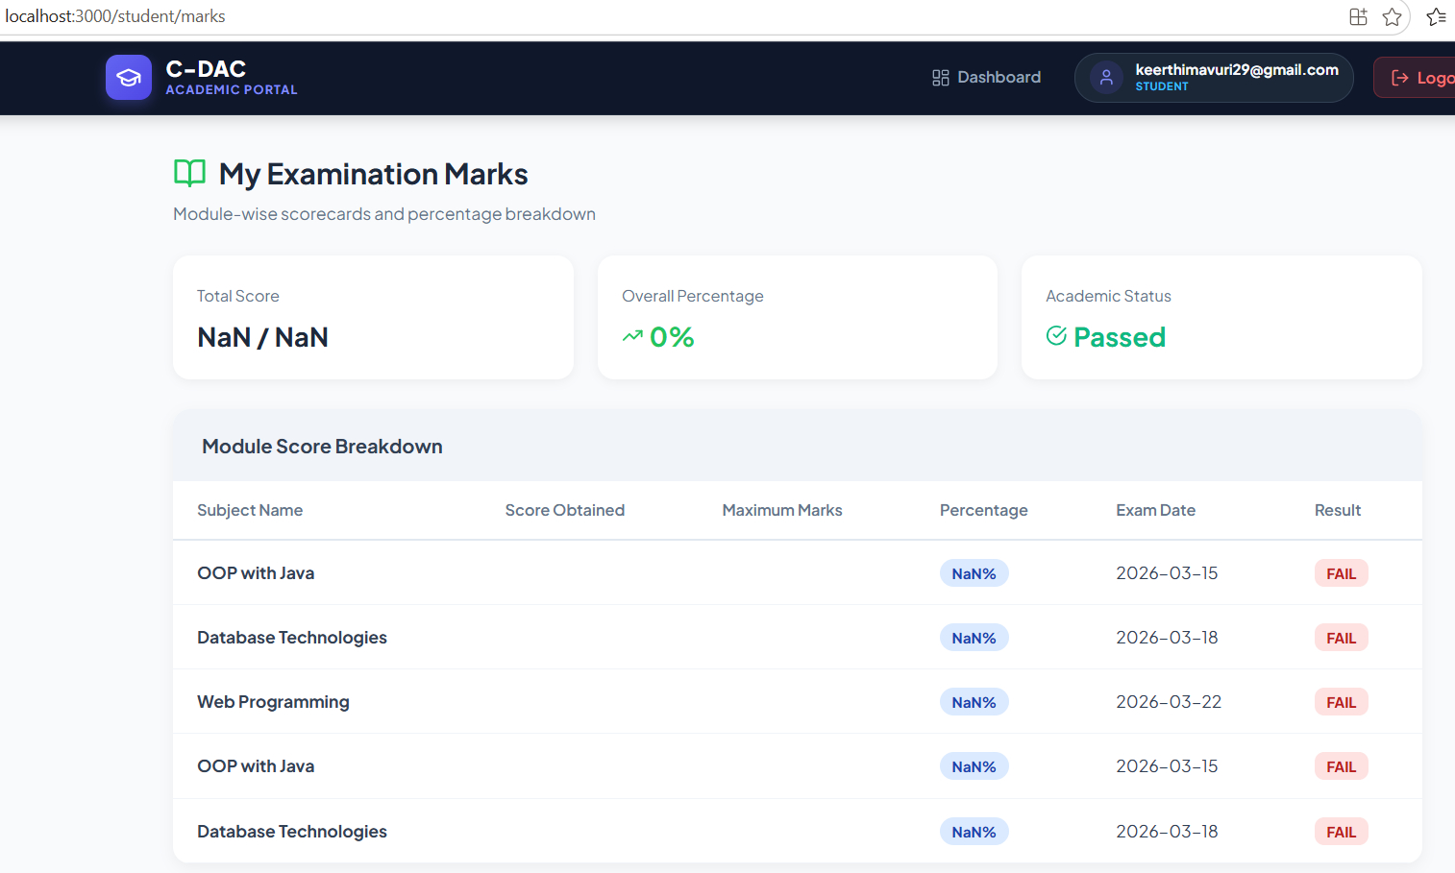
ACADEMIC MANAGEMENT
09
Examination marks
Module-wise scorecards provide a consolidated view of academic performance.
MARKS
• Displays module-wise examination records.
• Shows score, percentage and exam date.
• Result status is clearly visible.
• Supports quick academic review.
Key user value
Displays module-wise examination records.
C-DAC Student Management System

Slide 10
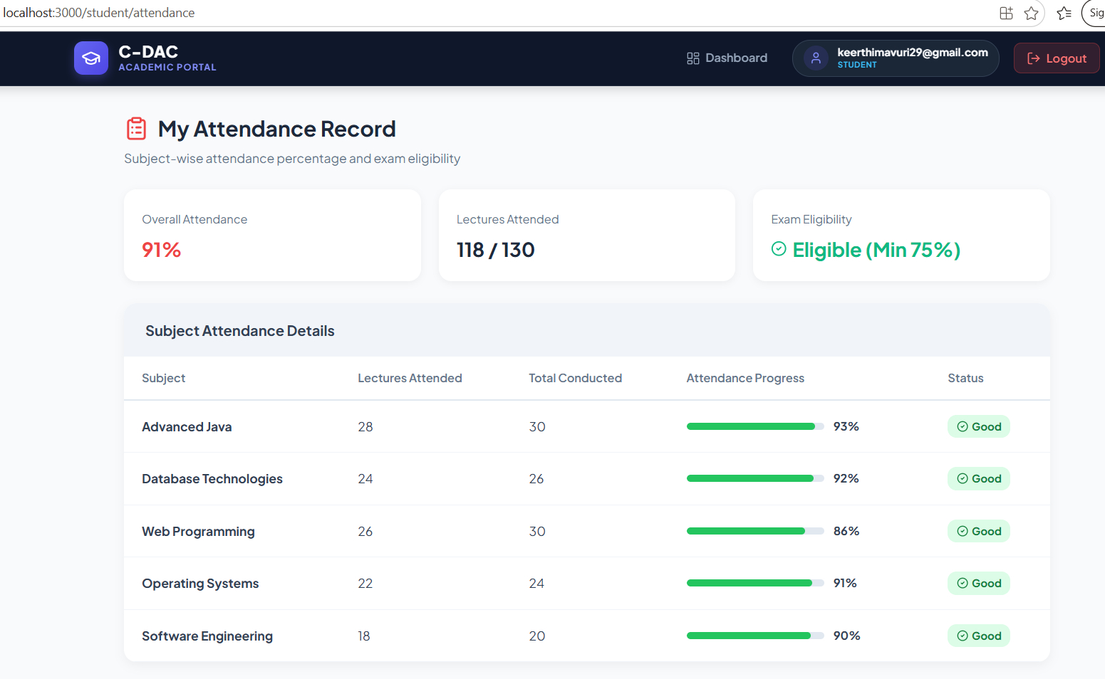
ACADEMIC MANAGEMENT
10
Attendance tracking
Students can monitor subject-wise attendance and understand examination eligibility.
ATTENDANCE
• Overall attendance percentage.
• Lectures attended vs. total conducted.
• Subject-wise attendance progress bars.
• Eligibility indicator based on attendance.
Key user value
Overall attendance percentage.
C-DAC Student Management System

Slide 11
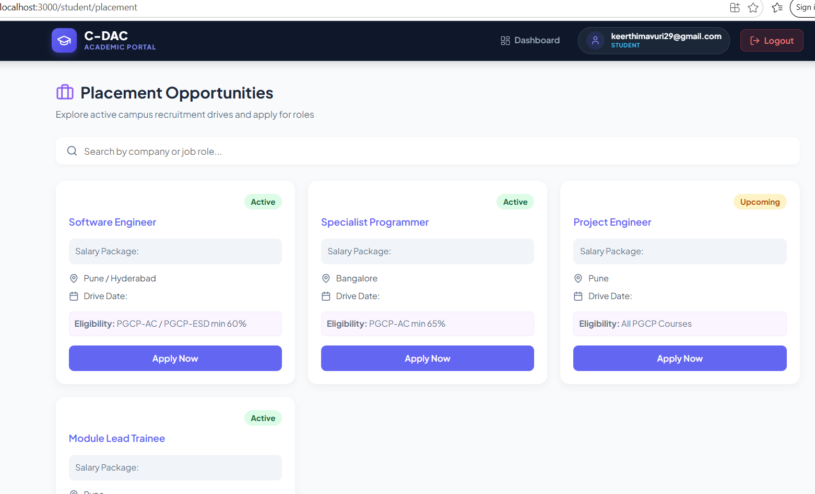
CAREER SERVICES
11
Placement opportunities
Students can discover active and upcoming campus recruitment drives.
PLACEMENT
• Search by company or job role.
• Active and upcoming drive status.
• Location and eligibility information.
• Apply Now action for eligible roles.
Key user value
Search by company or job role.
C-DAC Student Management System

Slide 12
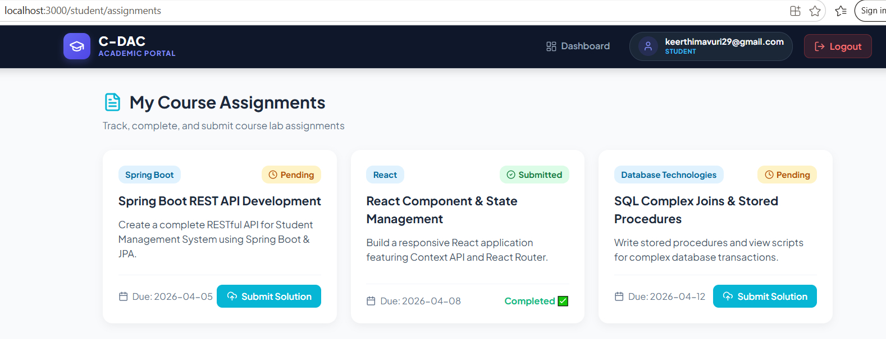
ACADEMIC MANAGEMENT
12
Course assignments
Assignments are organized by technology/module with status and due-date tracking.
ASSIGNMENTS
• Assignment title and module/category.
• Pending vs. submitted status.
• Due-date visibility.
• Submit Solution action.
Key user value
Assignment title and module/category.
C-DAC Student Management System

Slide 13
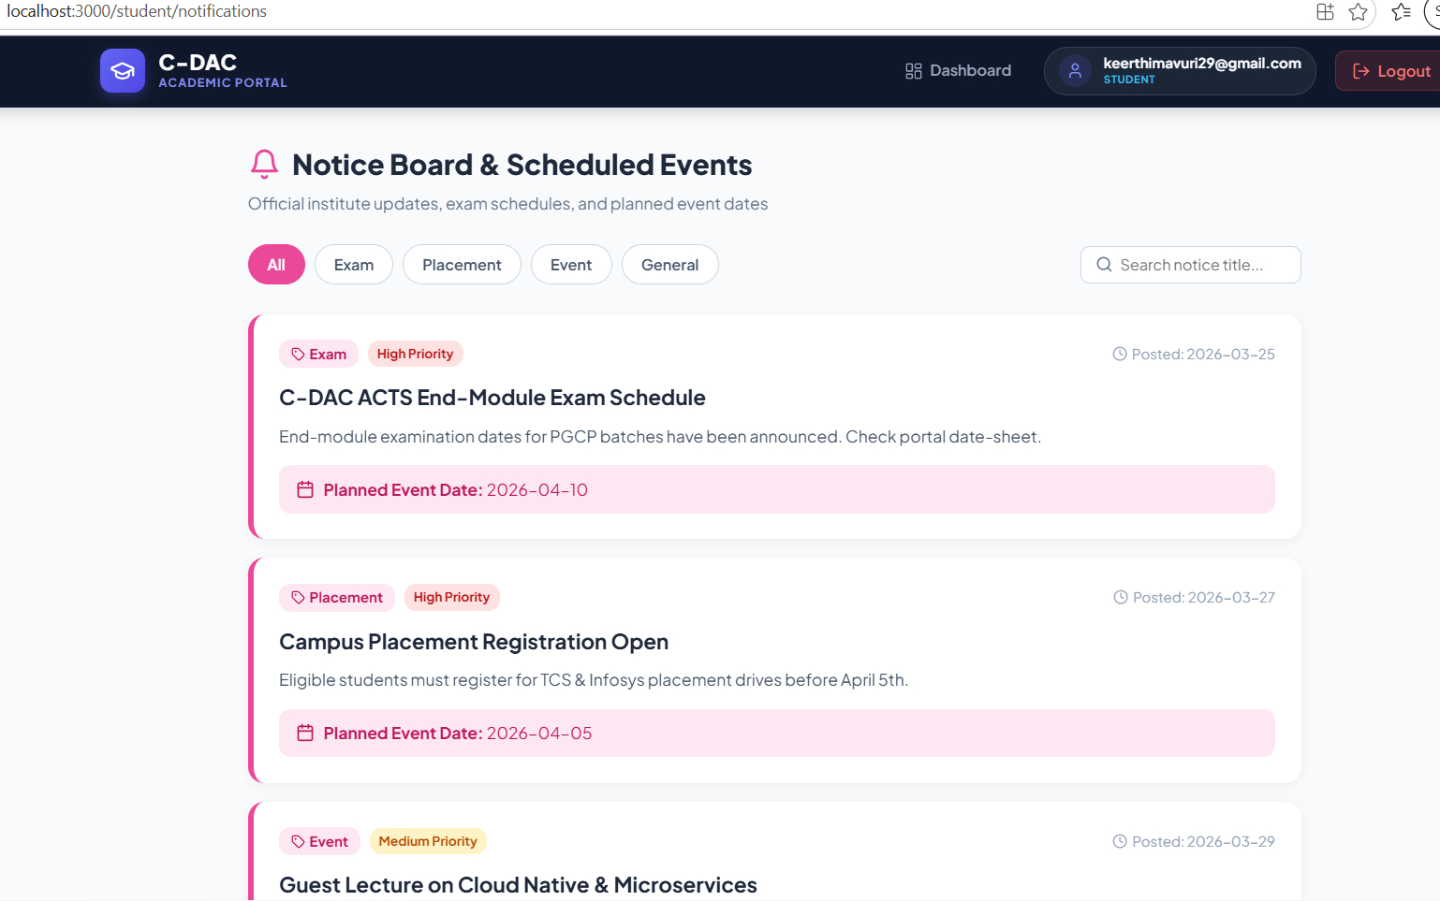
COMMUNICATION
13
Notice board & events
A centralized notice area keeps students informed about important academic activities.
NOTICES
• Exam, placement, event and general categories.
• Priority indicators for important notices.
• Posted date and planned event date.
• Search for notices by title.
Key user value
Exam, placement, event and general categories.
C-DAC Student Management System

Slide 14
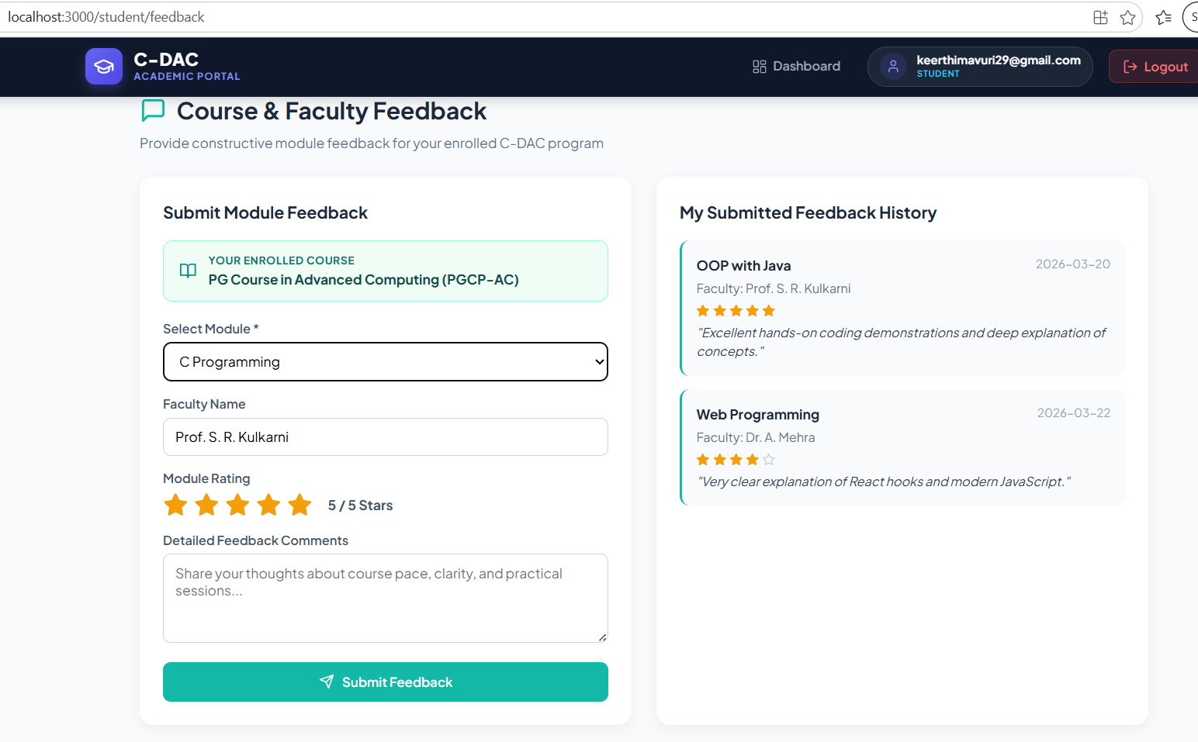
COMMUNICATION
14
Course & faculty feedback
Students can rate modules and faculty and maintain a history of submitted feedback.
FEEDBACK
• Select module and faculty.
• Star-based module rating.
• Detailed feedback comments.
• Submitted feedback history.
Key user value
Select module and faculty.
C-DAC Student Management System

Slide 15
SYSTEM HIGHLIGHTS
15
What the portal delivers
The project covers the complete student-facing academic journey.
01
Authentication
02
Academics
03
Attendance
Login & registration
Profile & marks
Progress & eligibility
Integrated student service
Integrated student service
Integrated student service
04
Career
05
Learning
06
Communication
Placement drives
Assignments
Notices & feedback
Integrated student service
Integrated student service
Integrated student service
C-DAC Student Management System

Slide 16
PROJECT OUTCOME
A single digital platform
for student services
The C-DAC Student Management System brings academic records,
attendance, assignments, notices, feedback and placement opportunities
together in one organized portal.
✓
Centralized
One portal for daily student needs
✓
Accessible
Clear dashboards and simple navigation
✓
Scalable
Service-oriented backend for future growth
THANK YOU

